Slide 1
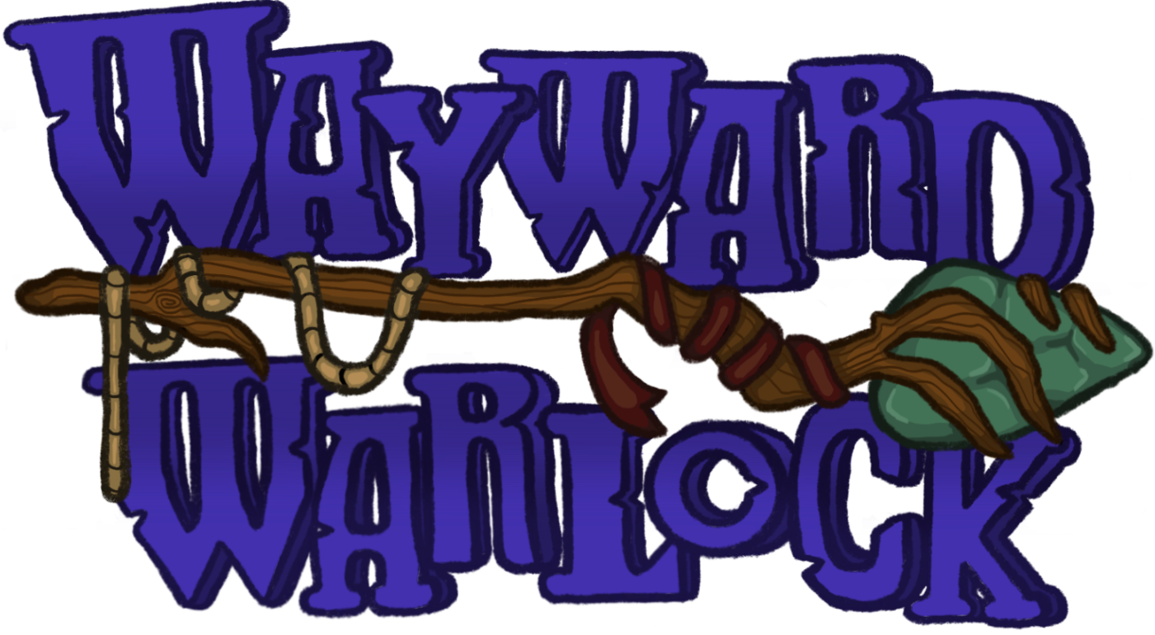
Green Team Project Pitch

Slide 2
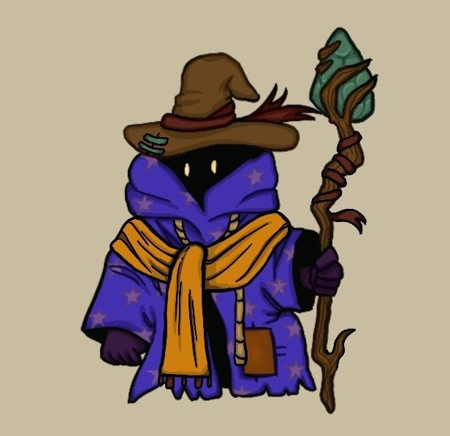
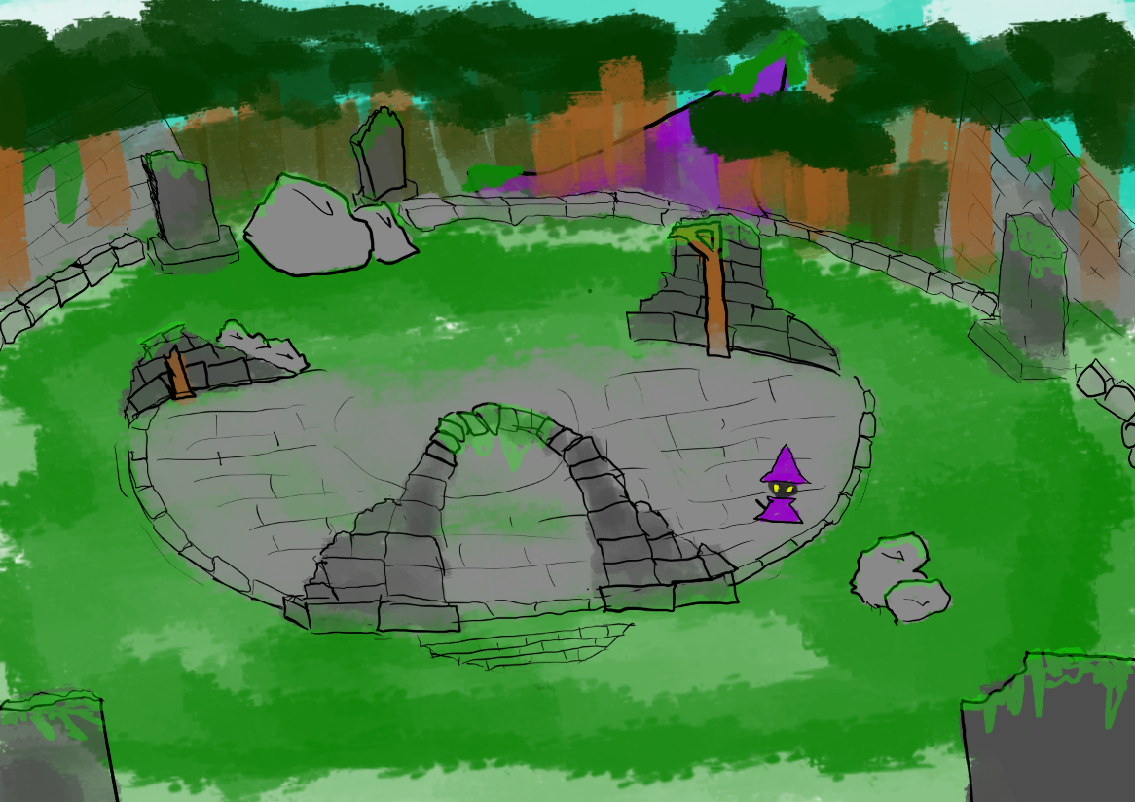
The Pitch
The game is a twin stick shoot ‘em up where you play as the final warlock named Wey taking his last stand against an army of Elemental Golems.
The goal is to survive as long as possible.
Defeat special Elemental Golems to receive temporary buffs to fend off the horde.

Slide 3
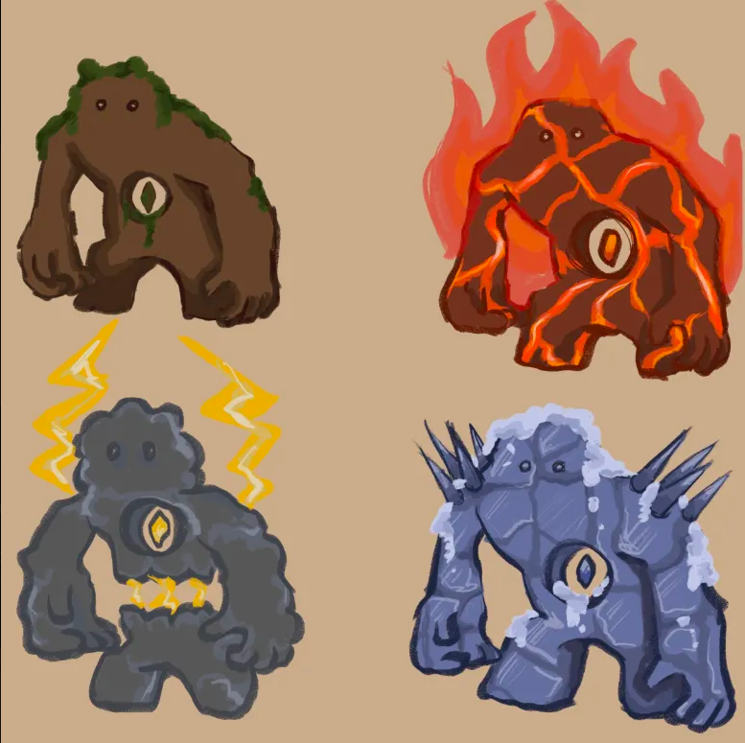
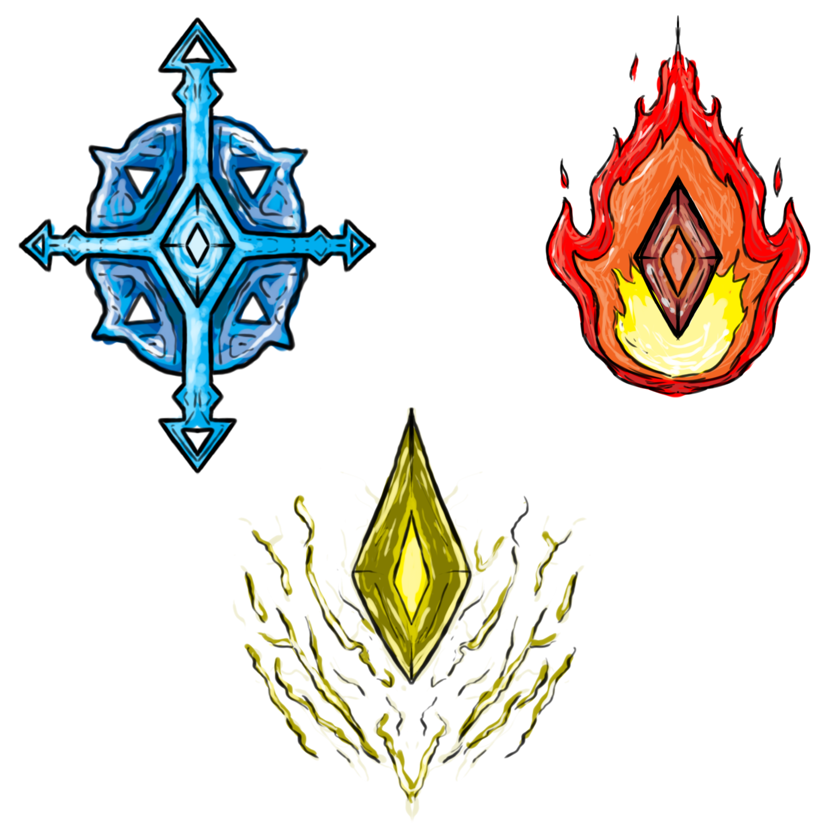
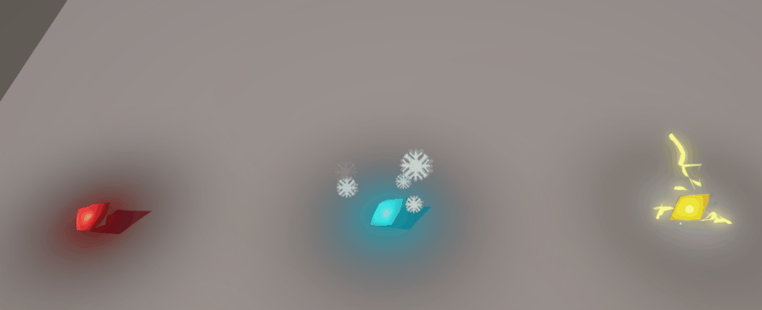
Core Mechanics and game loop
You will be slinging spells at the Golems, trying to preserve your health bar. With every attack, you build the Forbidden Magic Meter. Once full, you can unleash an attack that destroys all Golems on the screen.
You have 4 different attacks, 1 Basic and 3 Special
The Special attacks include:
Fire Attack - Bullet does tick damage
Ice Attack - Bullet slows enemies
Lightning Attack - Bullet chains between enemies
The 3 special attacks are gained after defeating Golems of the same type.

Slide 4
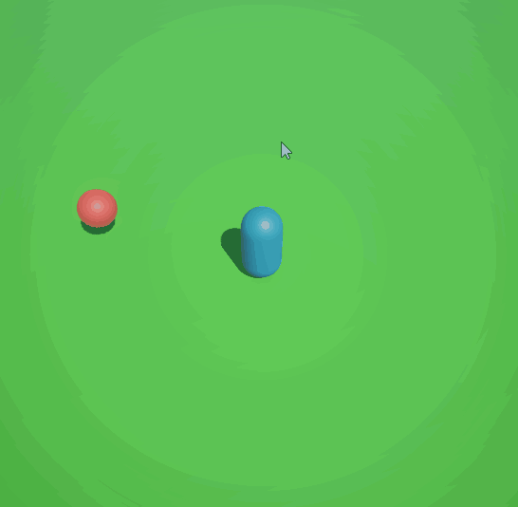
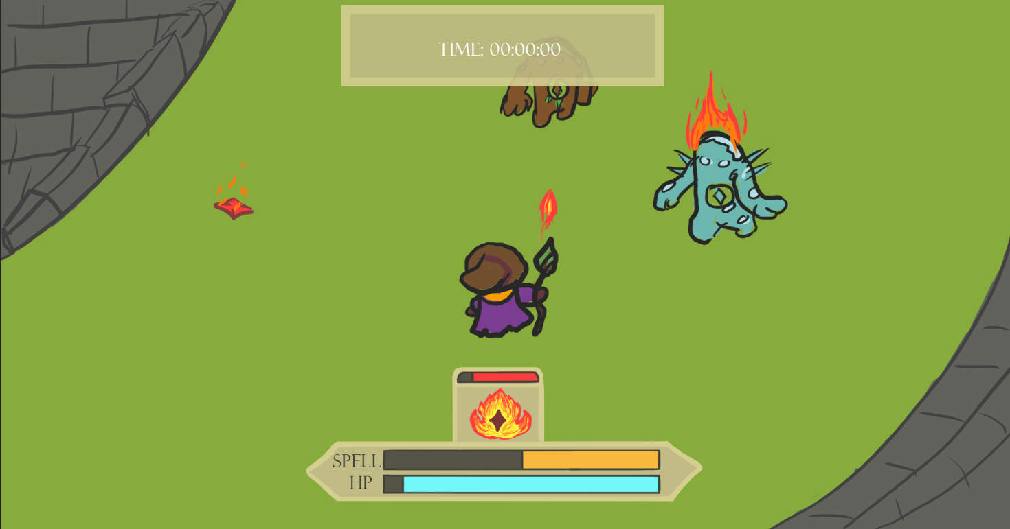
Gameplay mockup

Slide 5
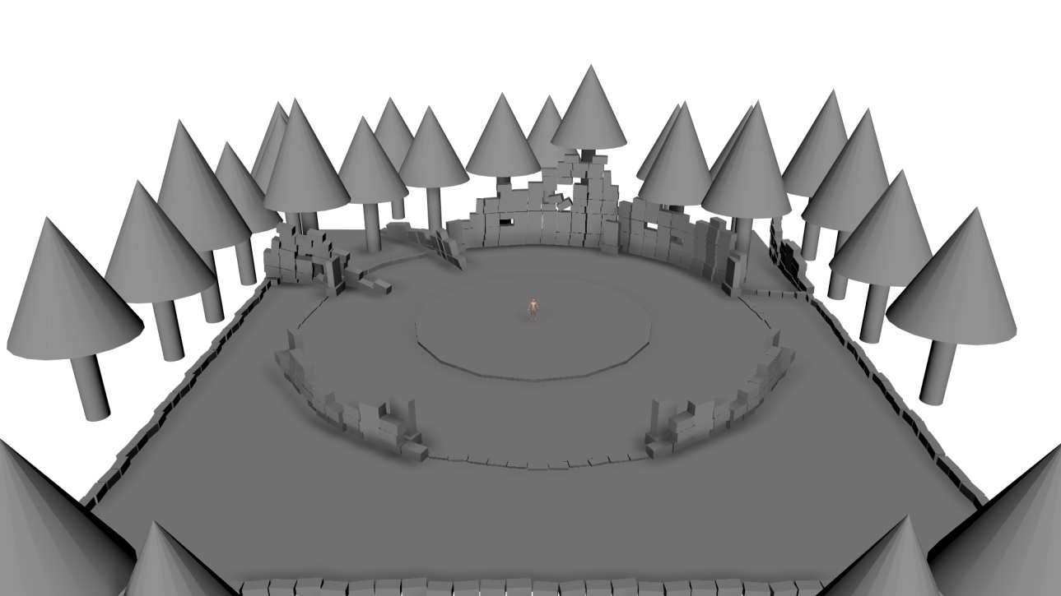
Environment Greybox

Slide 6
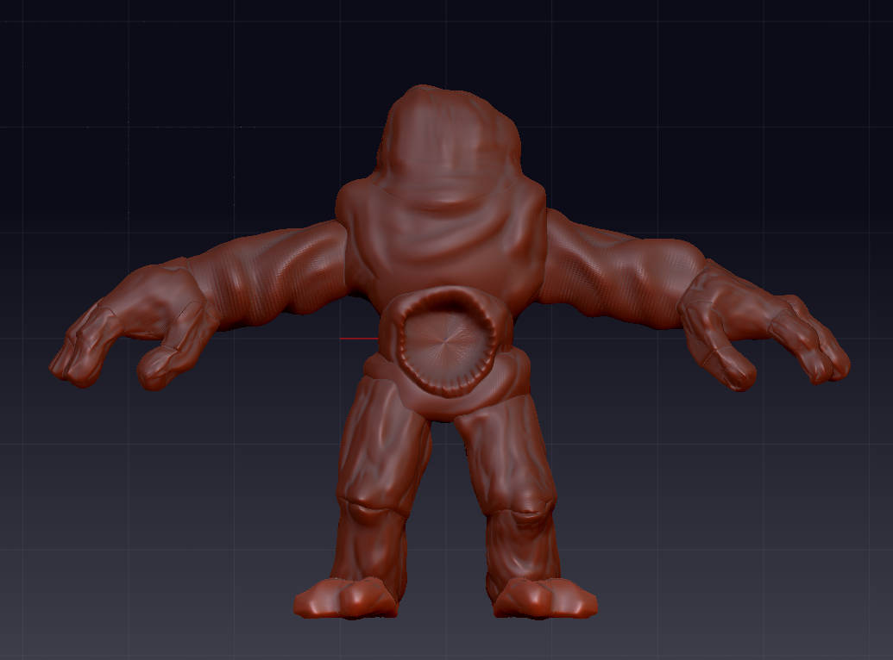
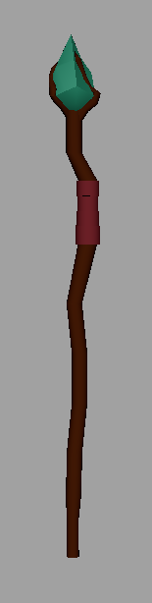
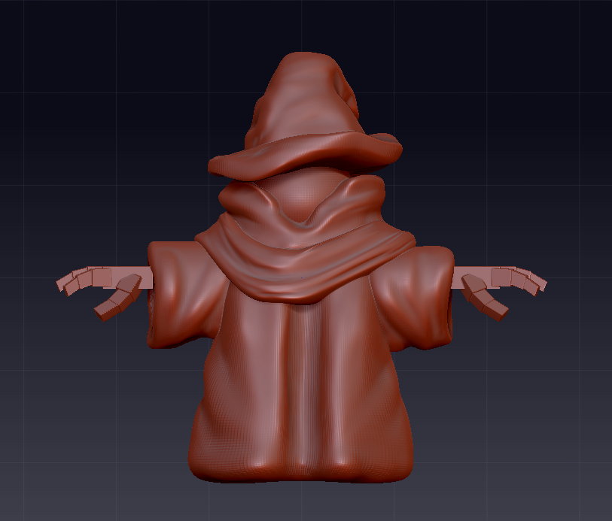
Character/Enemy Blockout

Slide 7
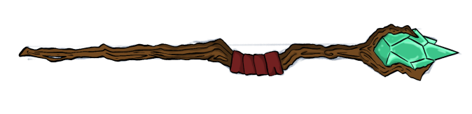
Lore
The warlock, Wey, was a part of a high esteem guild of warlock, teaching them the ways of magic to fight through dungeons to find fortune. Wey once taught a highly esteemed prodigy, Astroth. Astroth was power hungry, going beyond the teachings of Wey, and even able to clear a dangerous dungeons by himself. Through these adventures, he discovered the Elemental Catalyst.
Astroth took the elemental catalyst, able to create any elemental being or weapon, only limited by imagination. So Astroth attacked all guild members, to seek more power from them, leaving only his former teacher left. Astroth seeks to defeat Wey so he may rule unopposed. Wey must hold their own against the endless hoard of Astroth’s creatures created from the catalyst.
Wey finds themself in the ruins of their own guild hall, now with nothing else left to lose. They ready themself for their last fight against the horde of elemental golems, determined to fight until his last breath.

Slide 8
Risk analysis and stretch goals
Most of the risk comes from overscoping the design of different attacks, mainly the Forbidden Magic Attack. Stretch goals include:
Adding different effects to the different Special attacks
Making a custom animation and Visual Effect for the Forbidden Magic Attack
Creating multiple aesthetic animations for the Wizard and the Golems

Slide 9
Schedule and production timeline
Pre-Production | Alpha | Beta | Gold
Completed Bibles Build barebones prototype as proof of concept Production schedule Designing class Mockups | Create more rounded out version of the playable demo Getting Models into playable state Built in core mechanics | Create mostly finalized product Squash any bugs found before release Polish Features | Release full game with minimal or no bugs

Slide 10
Team members and roles
Artists | Programming
Jack - VFX Landon - 3D Character Design, Animator, & Concept Artist Sam - Concept Artist, UI Artist Aiden - Concept Artist & Environment Artist Mac - Lead character Artist, Character Rigging | Joe - Enemy AI & UI Chase - Player Mechanics

Slide 11
Questions?

